Slide 1
Zombie game
Nicholas English

Slide 2
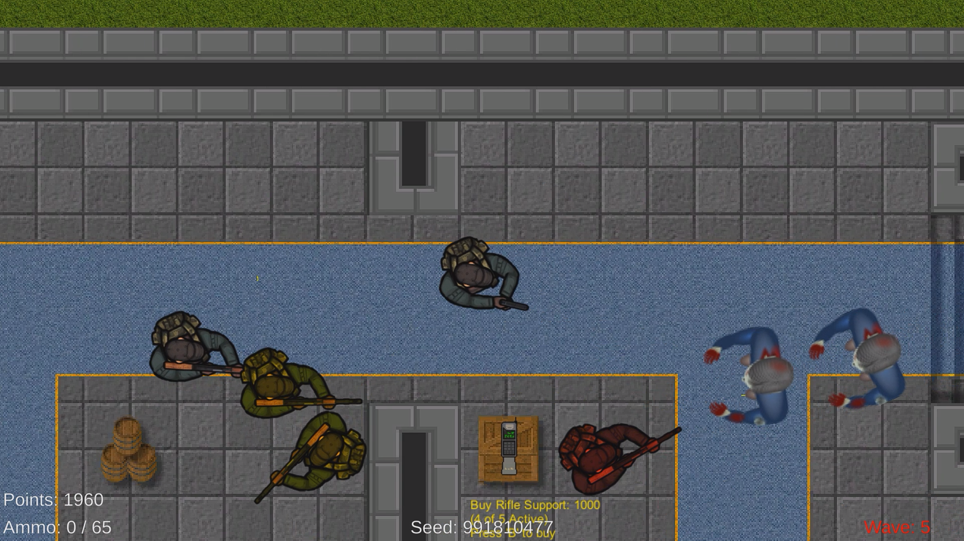
What is it?
Continuation of project from CIS-611
2D, Top-Down Zombie Survival Game
Inspired by Call of Duty Zombies
Created with the Unity Game Engine and coded in C#

Slide 3
Software Design Implementations

Slide 4
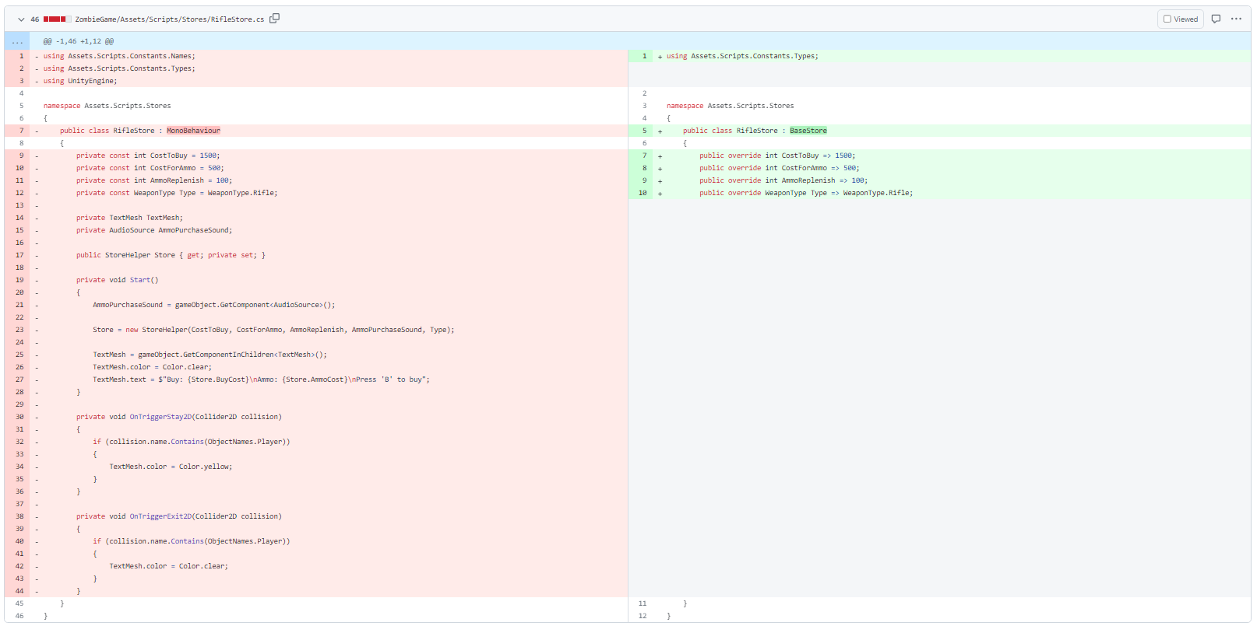
Refactoring: large class & Shotgun Surgery
Store Objects
Weapon Objects
Player Objects

Slide 5
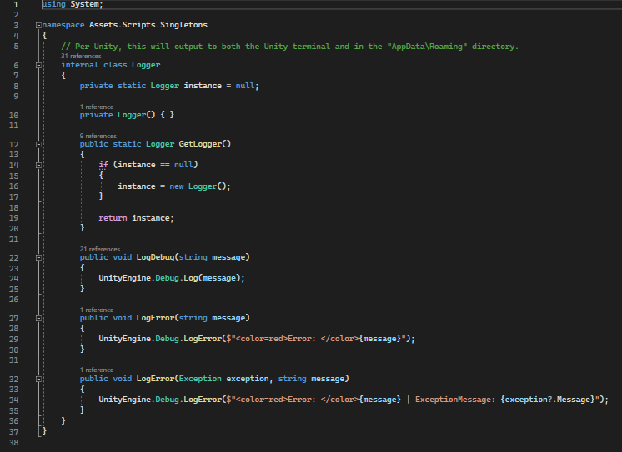
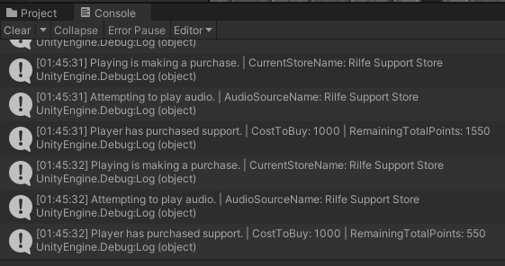
Lazy Singleton Logger
Why a logger?
Was it worth it?
Did refactoring help?

Slide 6
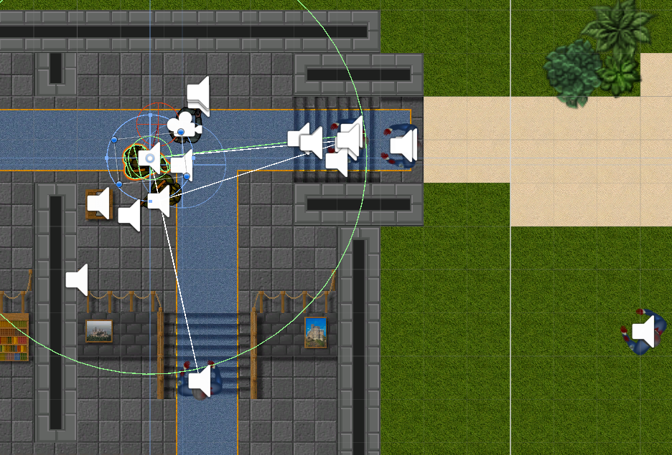
New Feature: Support Bots
Store Logic
NPC Logic
Human Logic
Did refactoring help?
Did logging help?

Slide 7
DEMO

